Slide 1
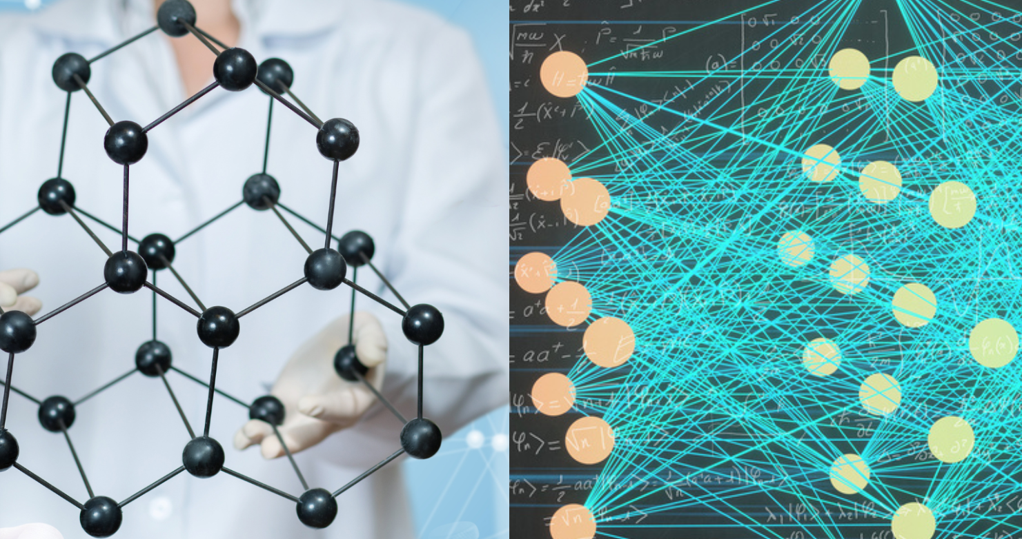

Application of High-Performance Computing and Machine Learning for Characterization of Nanostructures, Composite Materials, and Energy-Conversion Structures
Vasyl Kuryliuk and Oleg Olikh

Slide 2
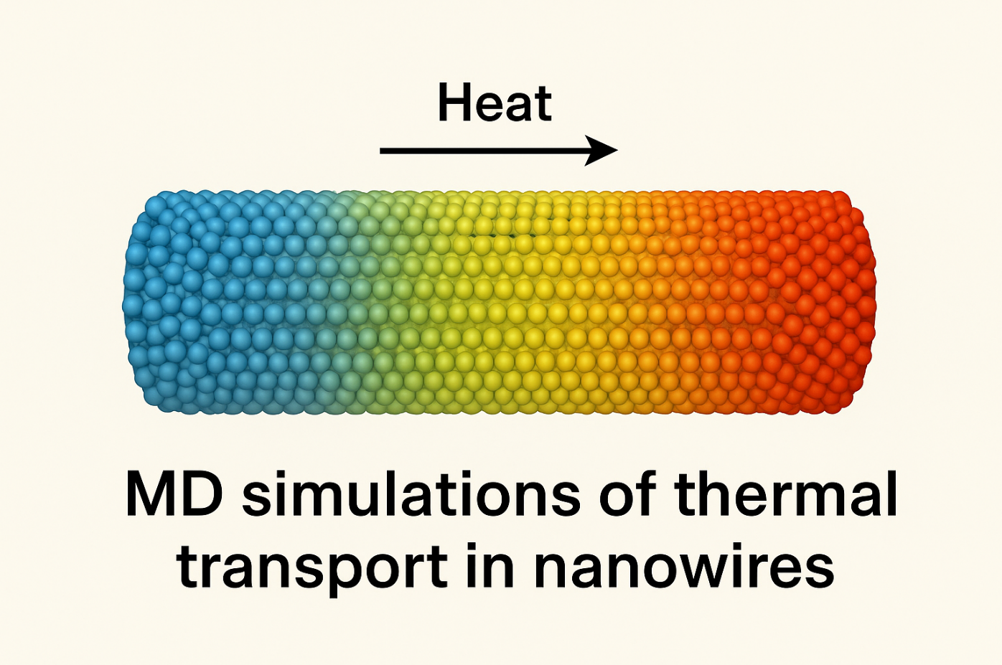
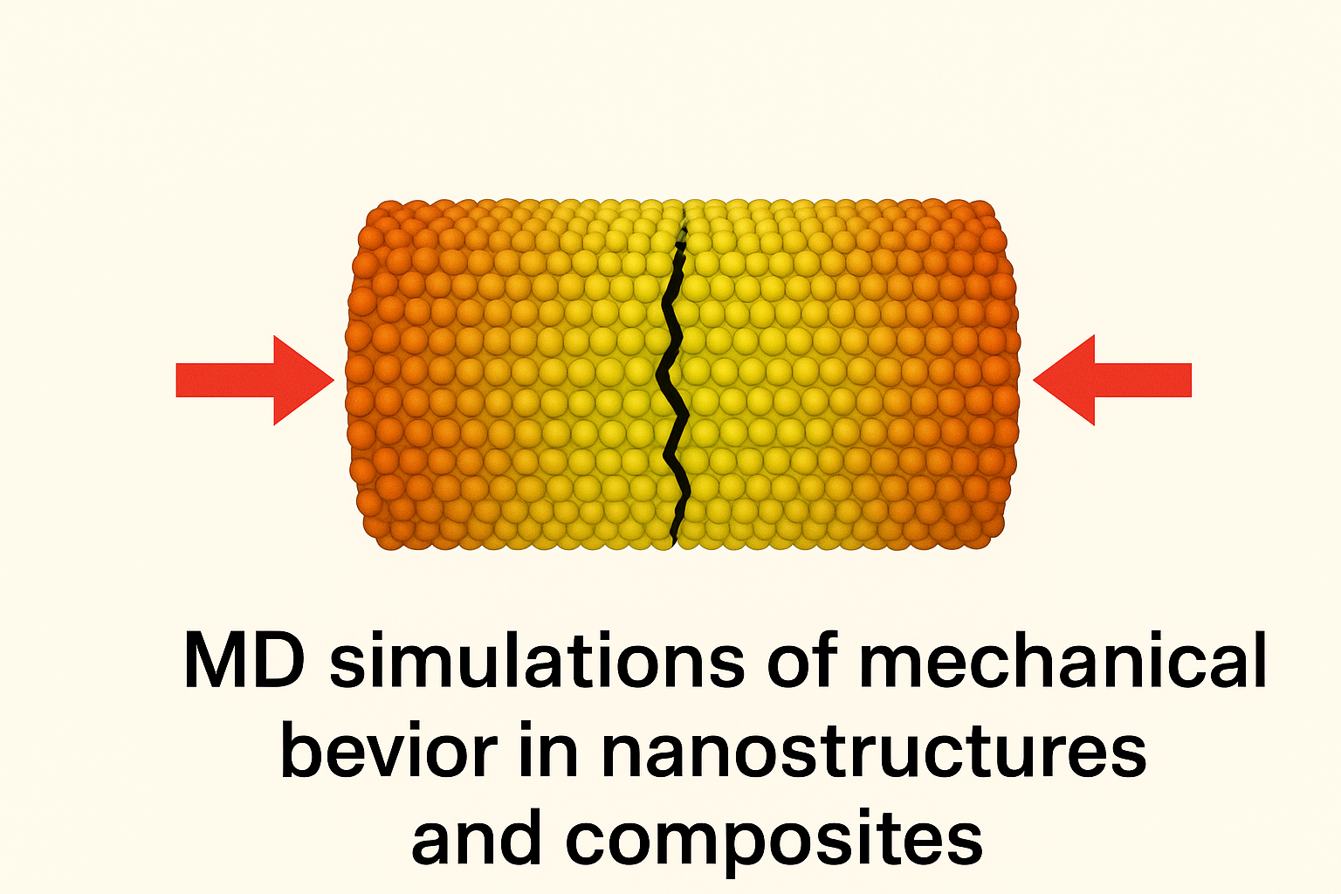
MD Simulations of Thermal Transport and Mechanical Behavior in Nanostructures and Composites

Slide 3
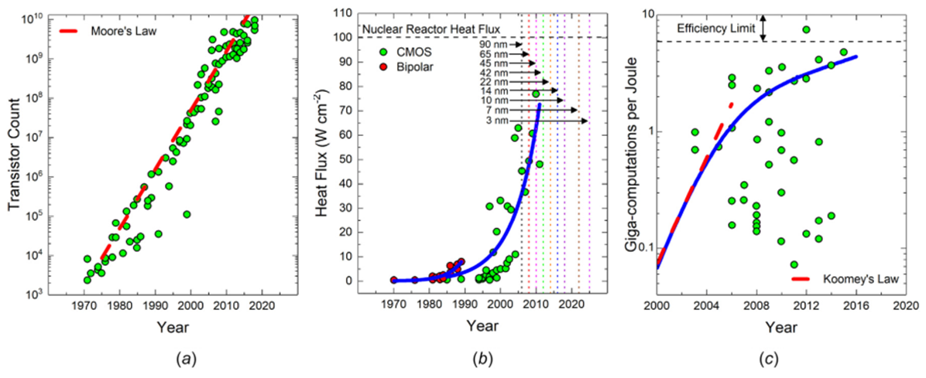
Thermal Transport Modeling: Motivation and Objectives
(a) Growth rate of transistor count in processors (Moore’s law); (b) Historical trend of heat flux in bipolar and CMOS processors; (c) Computational efficiency vs. year and transistor length scale.

Slide 4
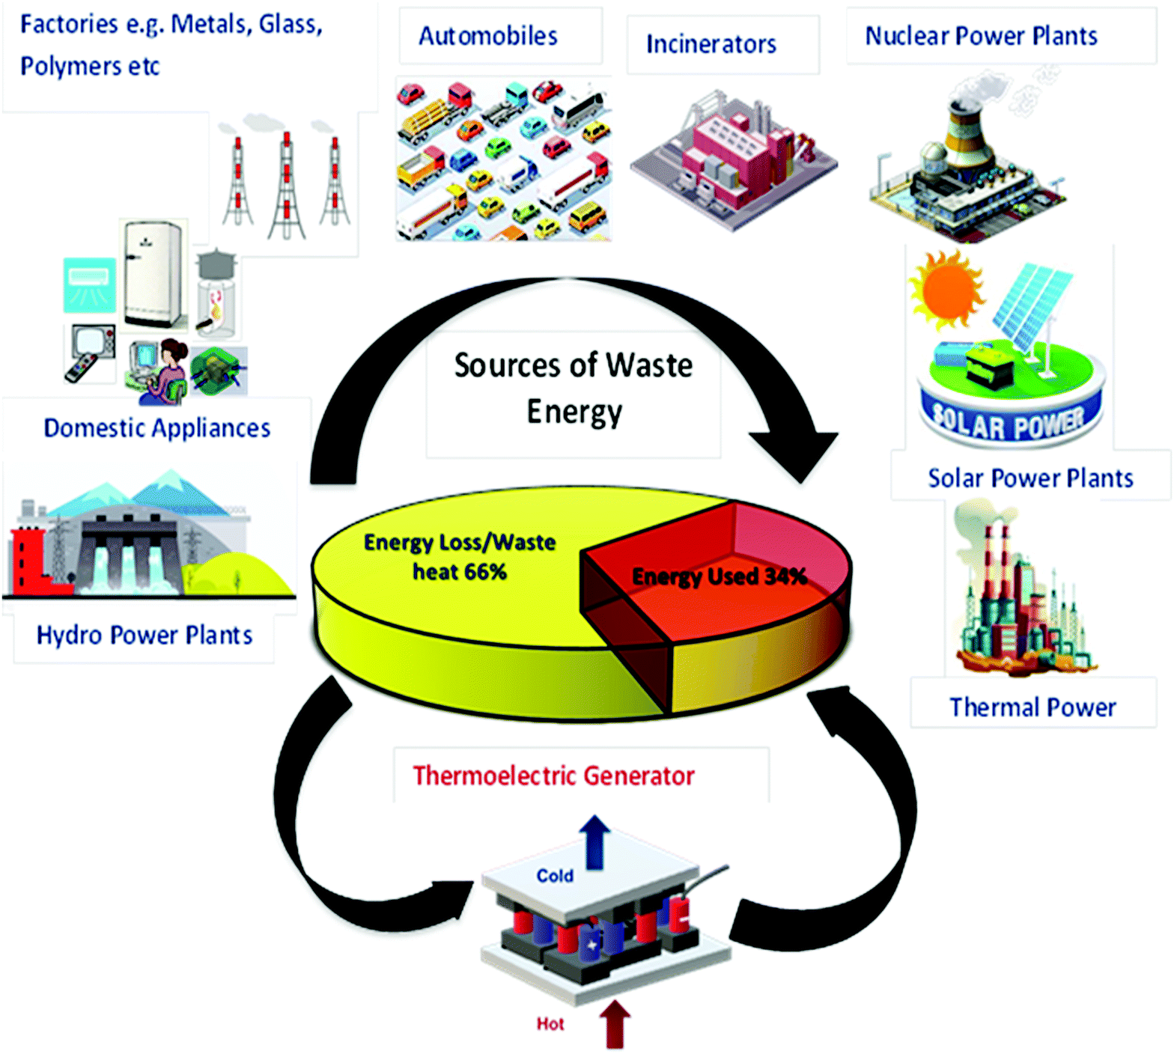
Thermal Transport Modeling: Motivation and Objectives
Schematic of the various types of waste energy sources and utilization of waste heat energy by a thermoelectric generator. (Mater. Adv., 2021, 2, 1927-1956)

Slide 5
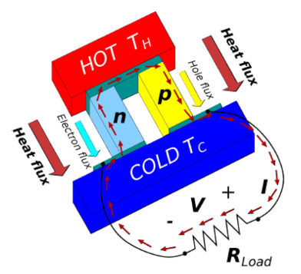
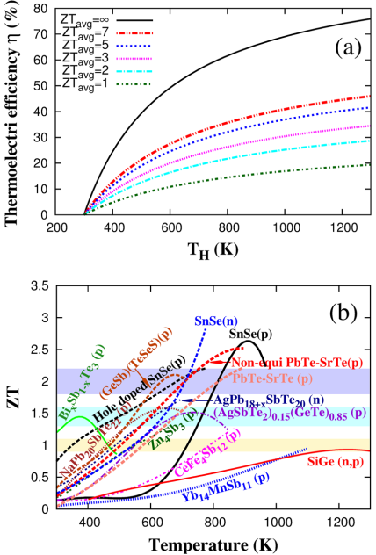
Thermal Transport Modeling: Motivation and Objectives
Thermoelectric efficiency vs. hot-side temperature (Tc = 300 K). The 20–30% range marks the threshold for fossil-fuel replacement.
Figure of merit (ZT) vs. temperature for several typical thermoelectric materials.

Slide 6
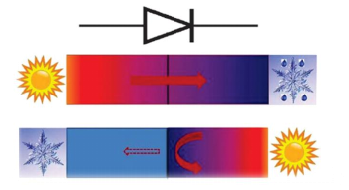
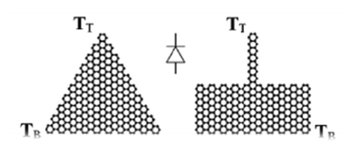
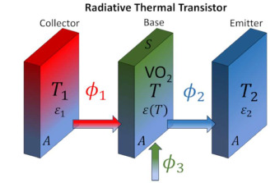
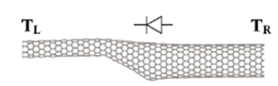
Thermal Transport Modeling: Motivation and Objectives
By implementing control and regulation of heat transport, it becomes possible to create devices analogous to electronic ones—thermal diodes, thermal transistors, and thermal memory elements.

Slide 7
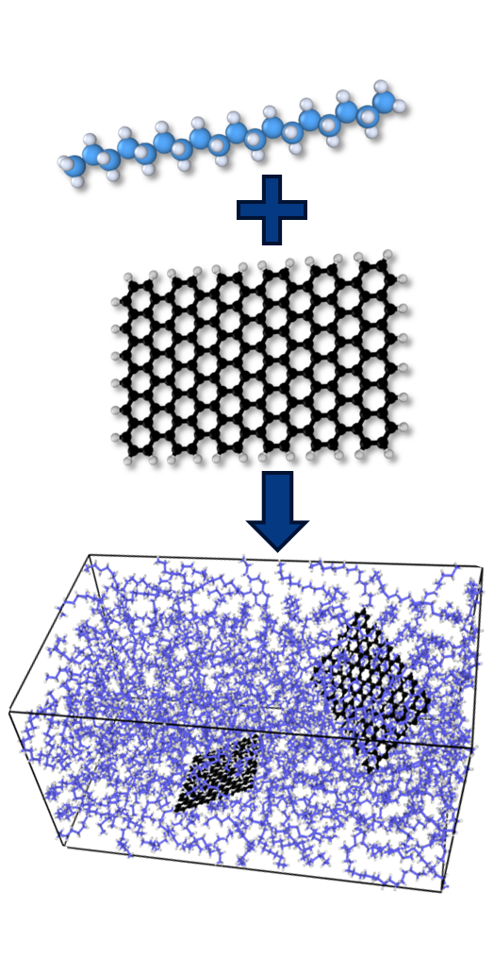
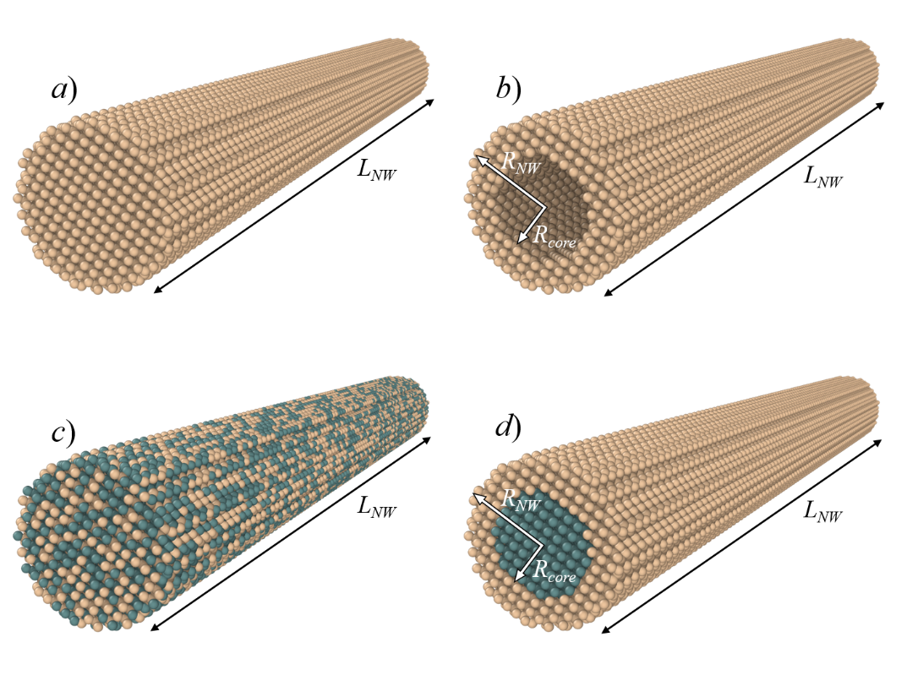
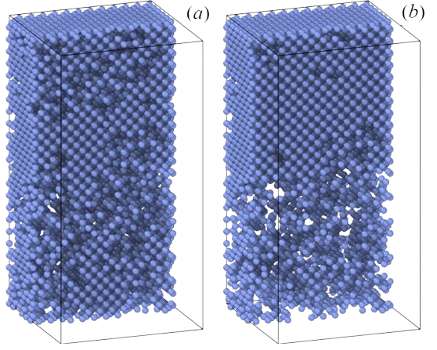
Atomistic Models for Thermal Transport Simulations
Modeled structures: SiGe nanowires; multilayer porous silicon structures;
composites based on phase-change materials.

Slide 8
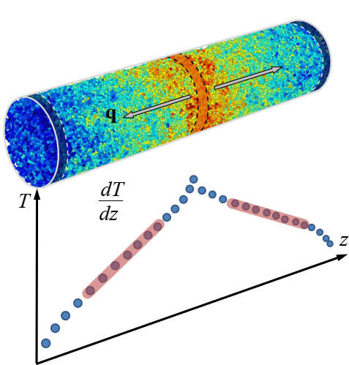
MD Simulation of Thermal Conductivity
NEMD Method for Thermal Conductivity:
Divide the system into thin slabs along the heat flow direction.
Periodically swap velocities between the fastest atom in the cold slab and the slowest atom in the hot slab.
Repeated exchanges create a steady temperature gradient.
Compute heat flux and thermal conductivity from the resulting profile.

Slide 9
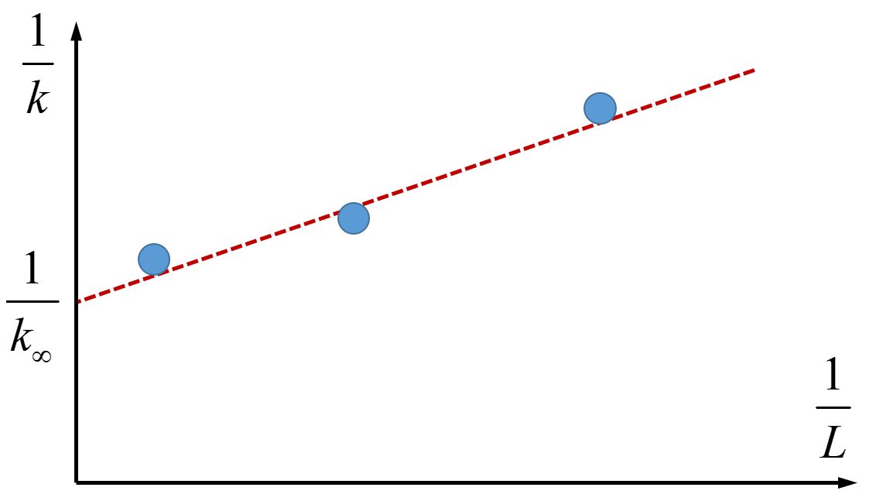
MD Simulation of Thermal Conductivity
L₁
L₂
L₃
Finite-size effects in thermal conductivity calculations using the NEMD method.

Slide 10
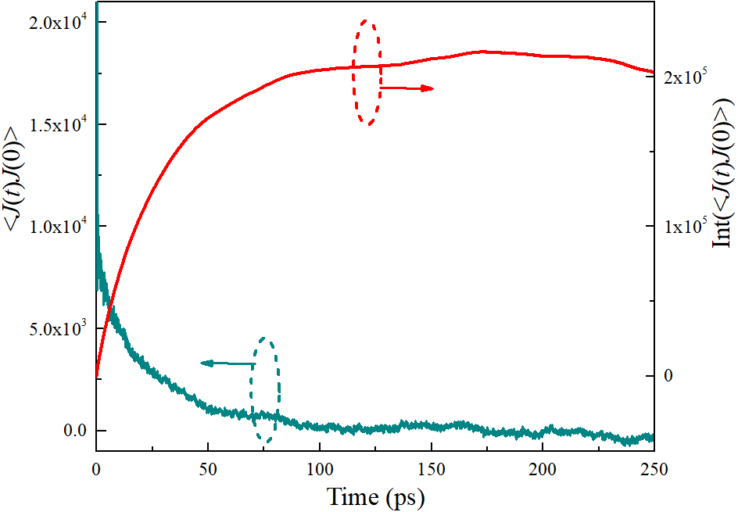
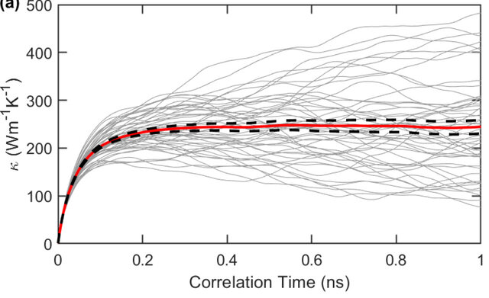
MD Simulation of Thermal Conductivity
Time dependence of the heat flux autocorrelation function and its integral value.

Slide 11
MD Simulation of Thermal Conductivity
Non-Equilibrium Molecular Dynamics (NEMD) Method | Equilibrium Molecular Dynamics (EMD) Method
Higher computational speed for the same number of atoms | Weak dependence of results on system size
Enables calculation of thermal boundary resistance between two materials | Allows calculation of thermal conductivity in all directions within a single simulation
Results depend on the system size | Lower computational speed
Thermal conductivity can be determined only along the imposed heat flow direction | Cannot determine thermal boundary resistance between two materials

Slide 12

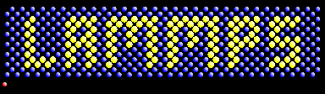
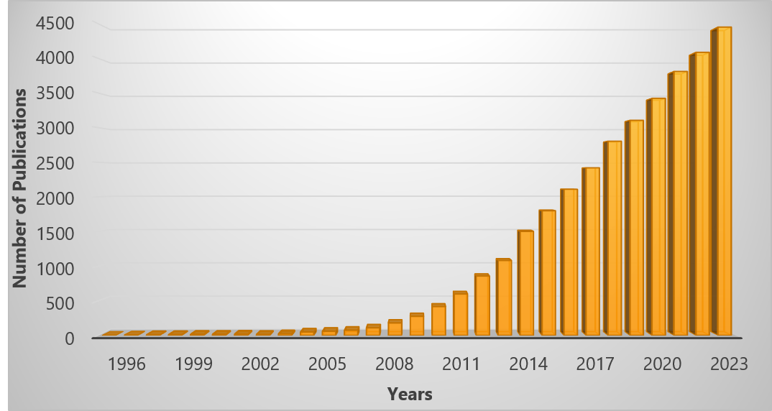
Computational Infrastructure
💎 Versatile molecular dynamics simulator: models solids, liquids, polymers, nanostructures, and biomolecules.
⚙ Supports a wide range of interatomic potentials — classical, reactive (ReaxFF), machine-learned (MLP), and hybrid quantum–classical (QM/MM) models.
⏩ Highly scalable performance — efficiently parallelized for thousands of CPU cores and GPU-enabled clusters.
🔬 Extensible and interoperable — integrates with VASP, Quantum ESPRESSO, ASE, Python interfaces, machine learning libraries, and data analysis tools.
https://www.lammps.org
Number of publications using LAMMPS by year

Slide 13
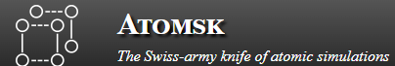

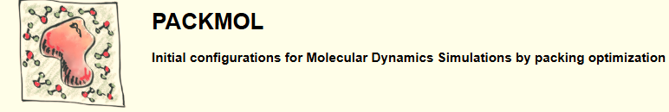
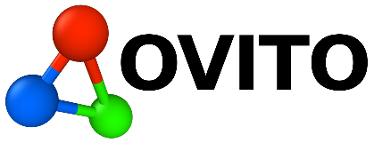
Computational Infrastructure
Tools for Pre- and Post-Processing:
Tool for building, converting, and manipulating atomic structures for simulations
Script-based builder for complex molecular systems and LAMMPS input files
Generates initial atomic configurations by packing molecules without overlaps
Visualization and analysis software for atomistic simulation data

Slide 14
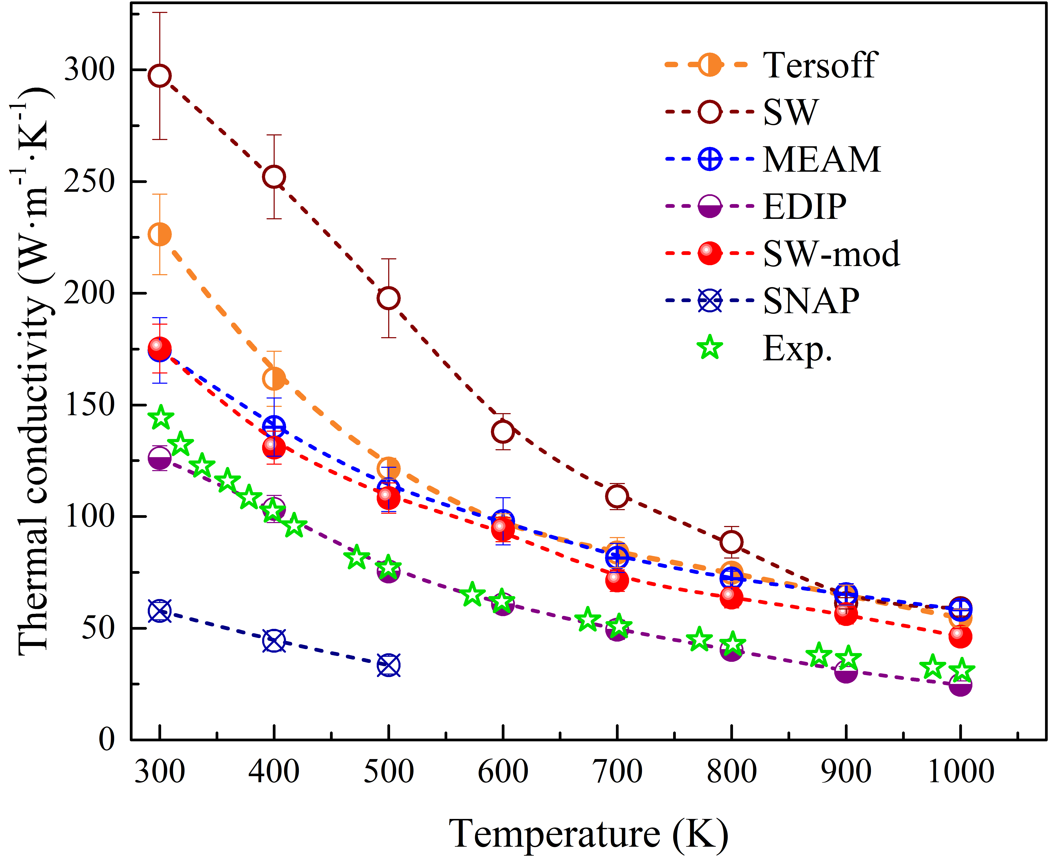
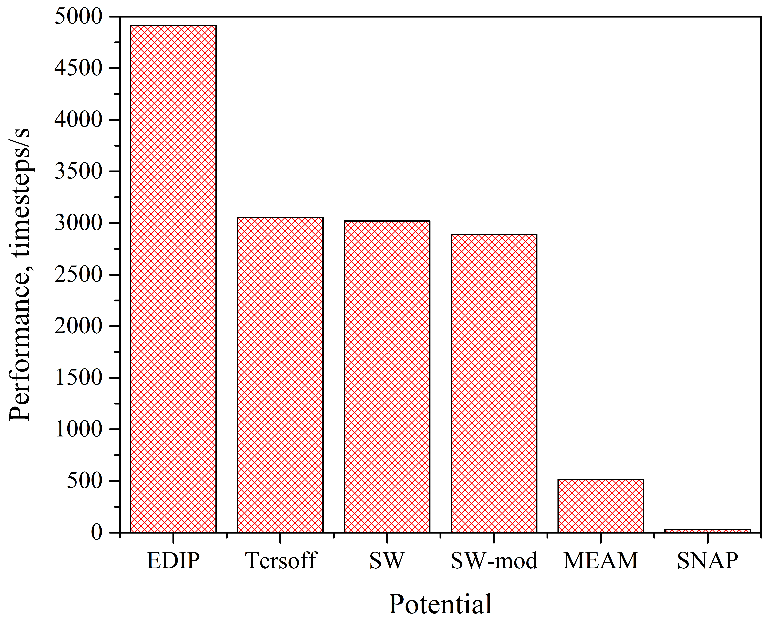
Validation of Interatomic Potentials
Results of testing interatomic interaction potentials for MD simulations of thermal conductivity in single-crystal silicon.

Slide 15
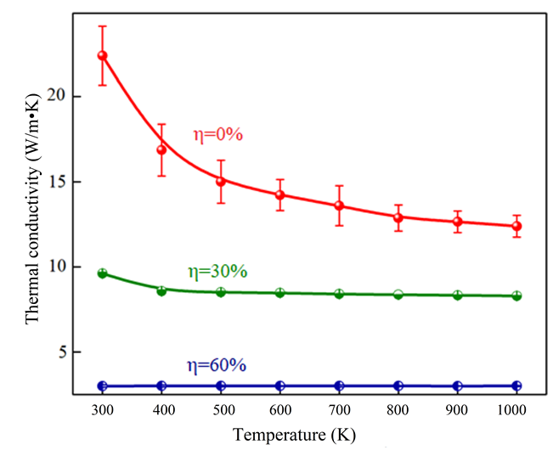
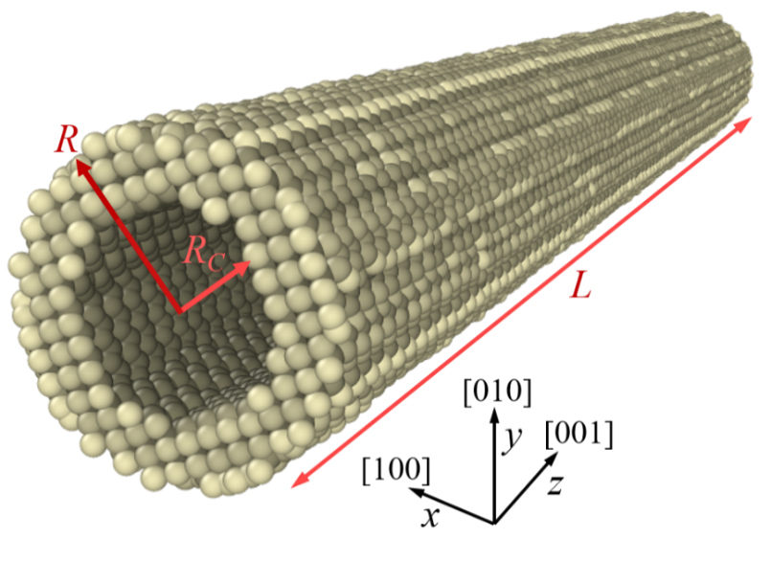
SiGe Nanowires: Results and Analysis
Atomic model (left) and thermal conductivity simulation results (right) for silicon hollow nanowires.

Slide 16
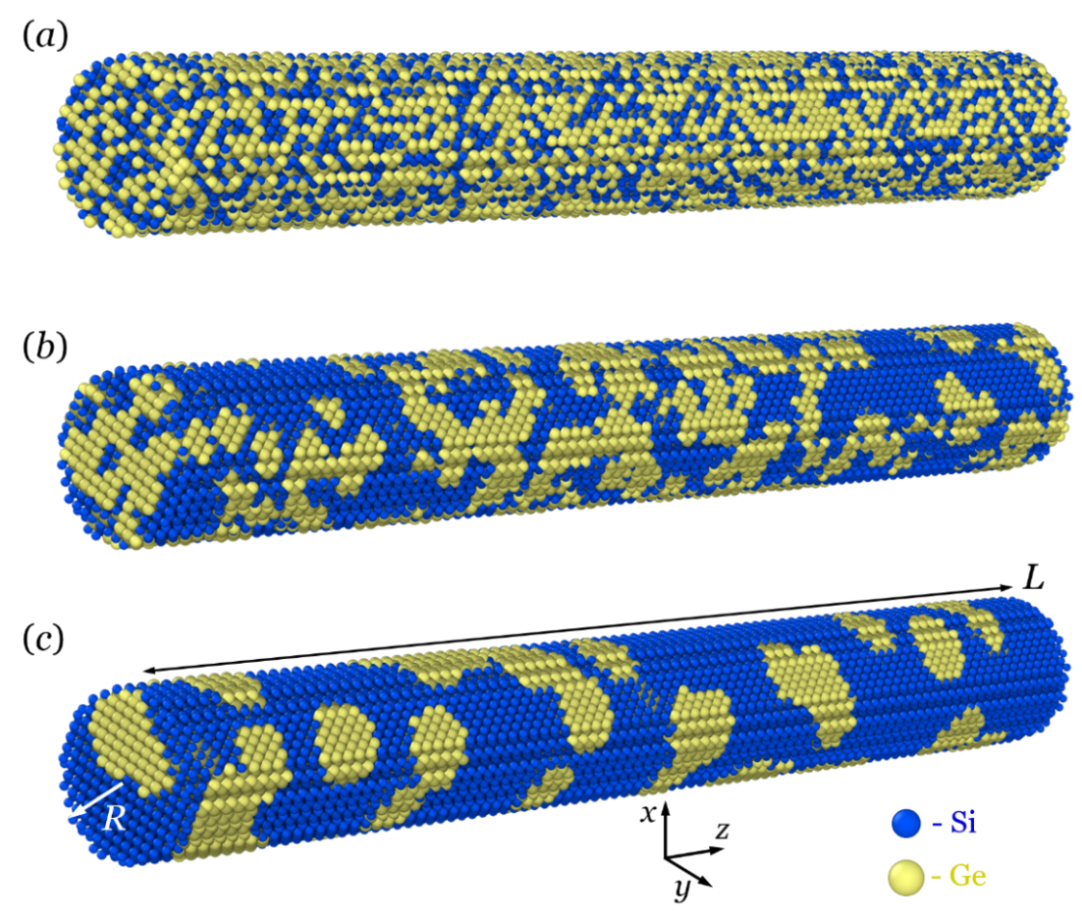
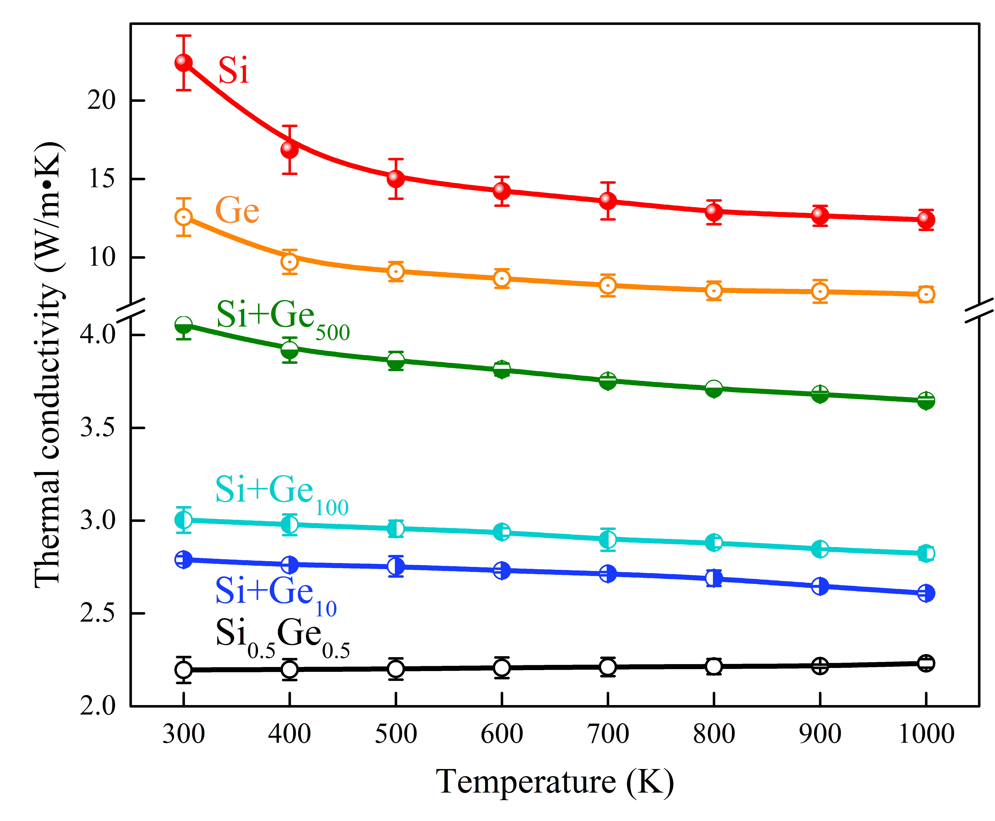
SiGe Nanowires: Results and Analysis
Atomistic representations (left) and corresponding thermal conductivity simulation results (right) for SiGe nanowires containing germanium clusters.

Slide 17
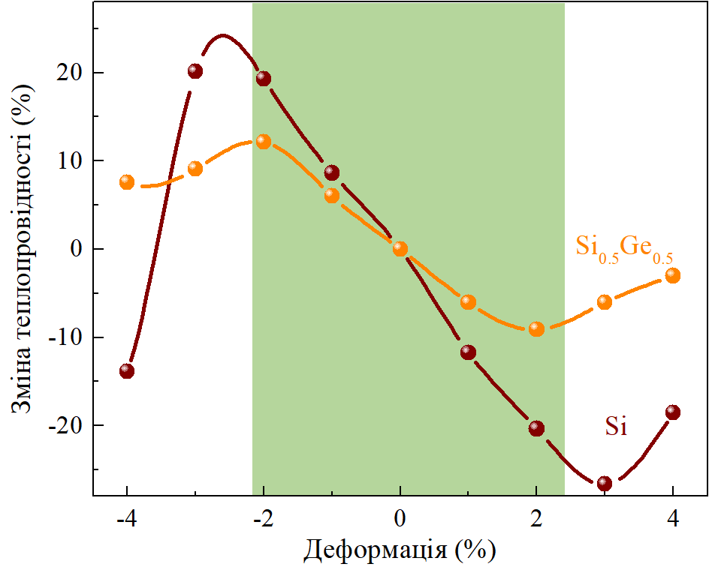
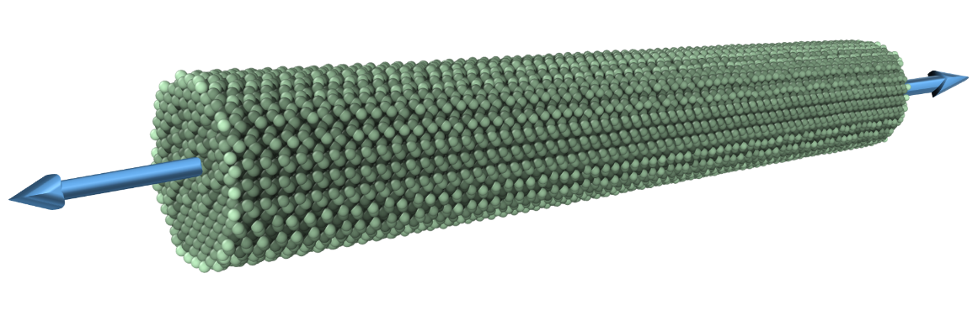
SiGe Nanowires: Results and Analysis
Change in thermal conductivity (%)
Strain (%)
Effects of strain on the thermal conductivity of Si and SiGe nanowires.

Slide 18
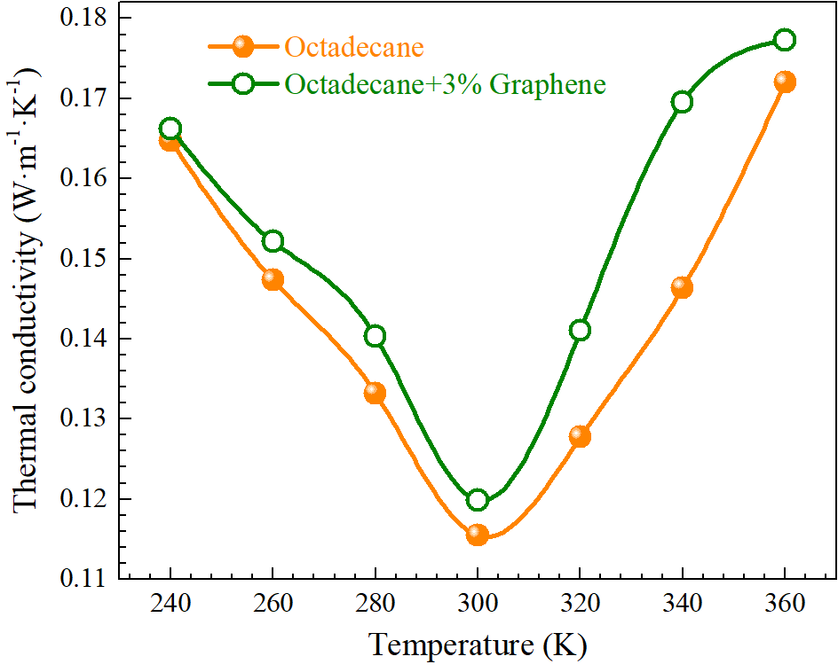
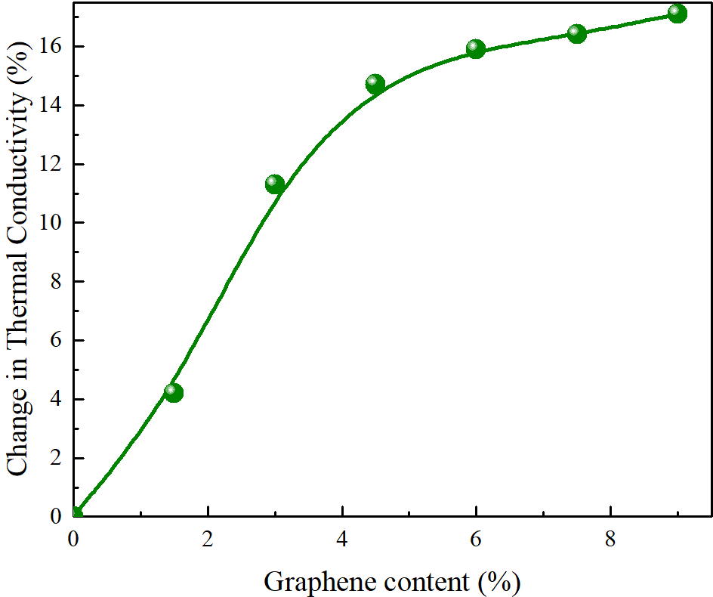
Phase-Change Composites
Thermal conductivity simulation results of phase-change composites with graphene inclusions.

Slide 19
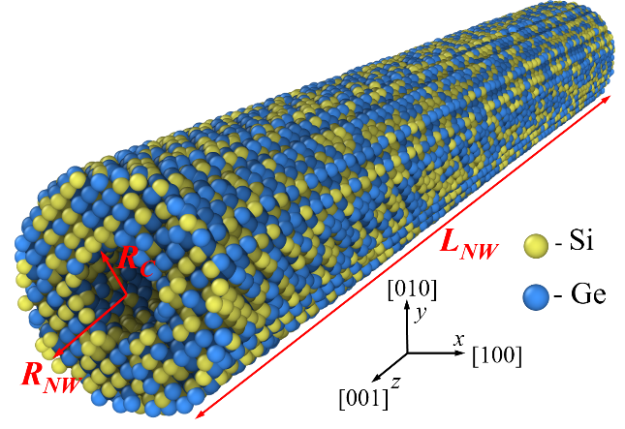
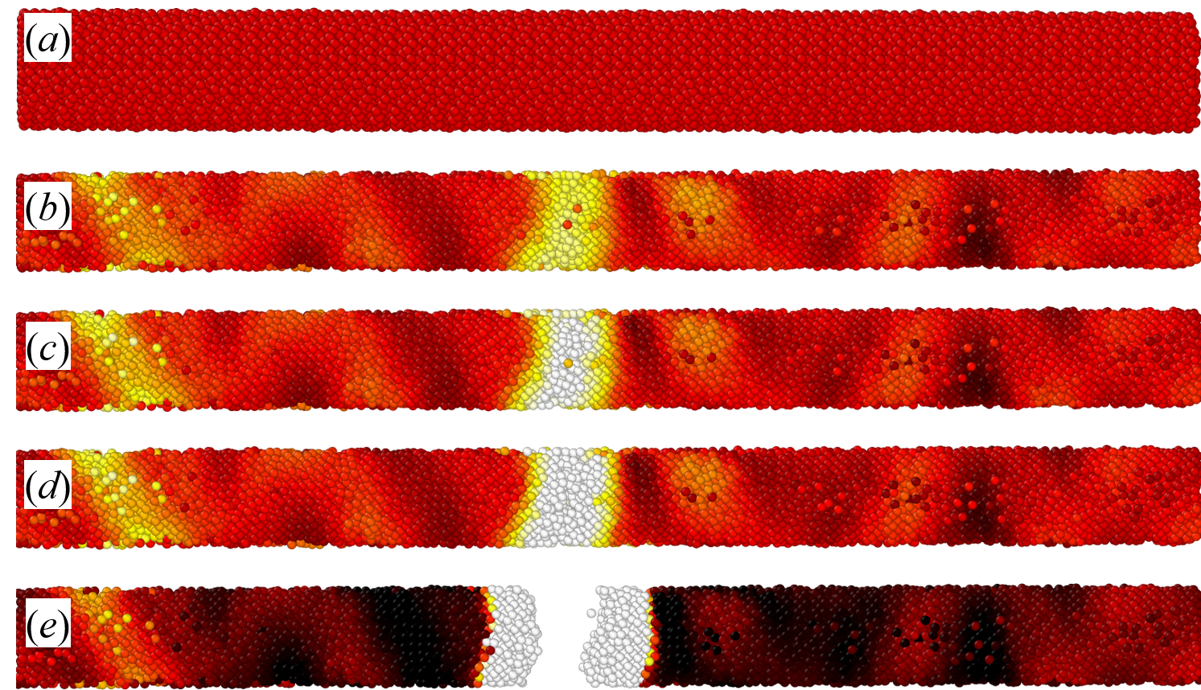
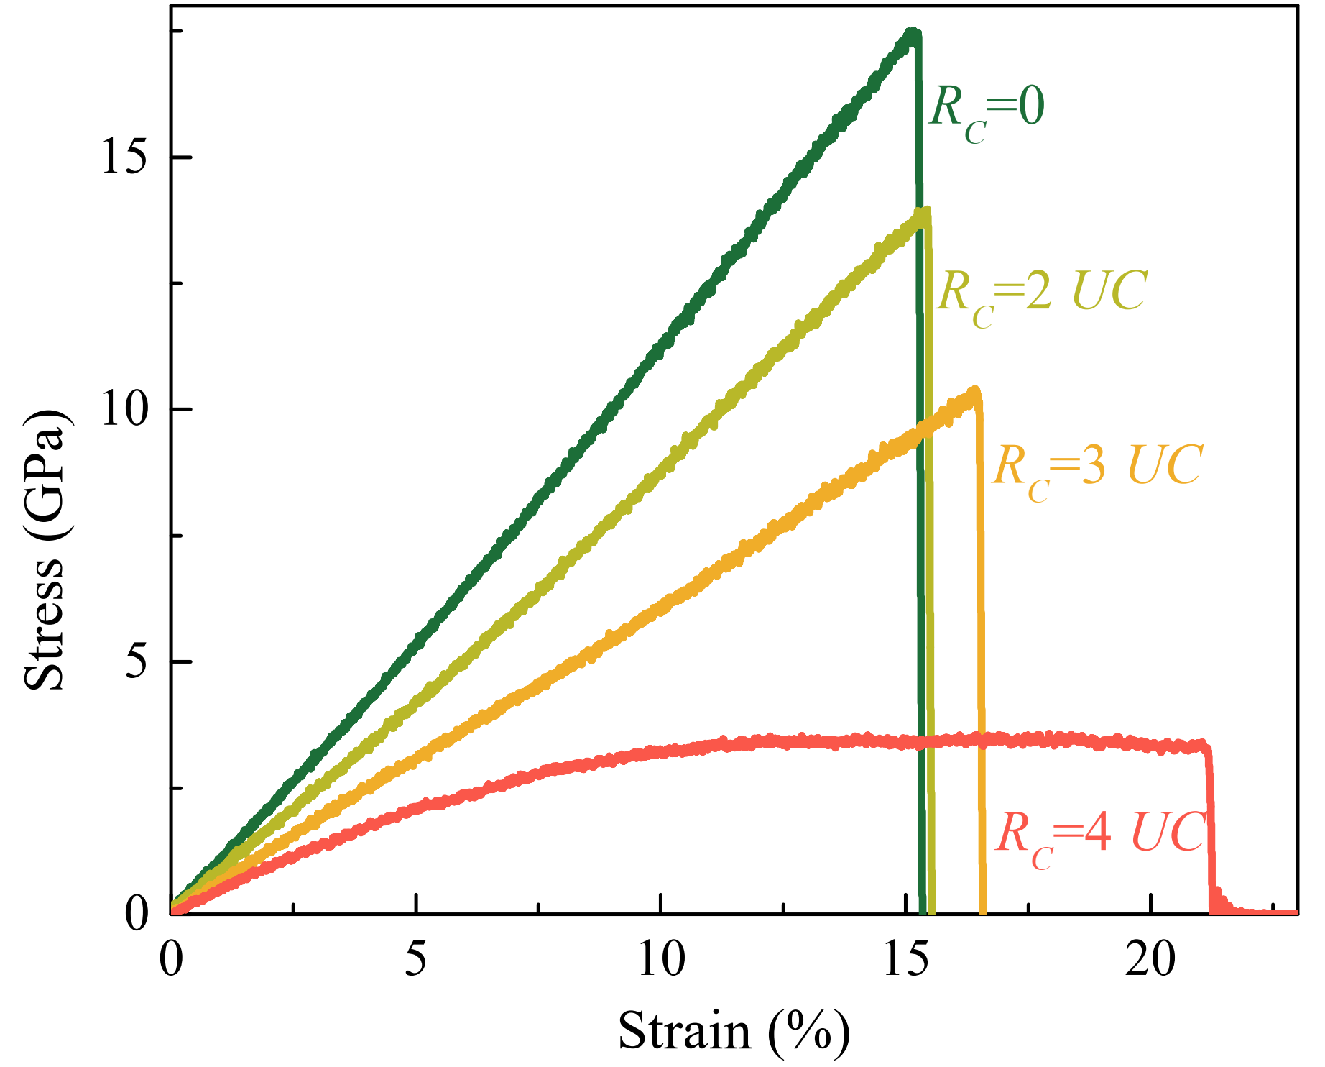
Mechanical Behavior Modeling: Motivation and Objectives
Simulation results of the mechanical response of SiGe nanowires.

Slide 20
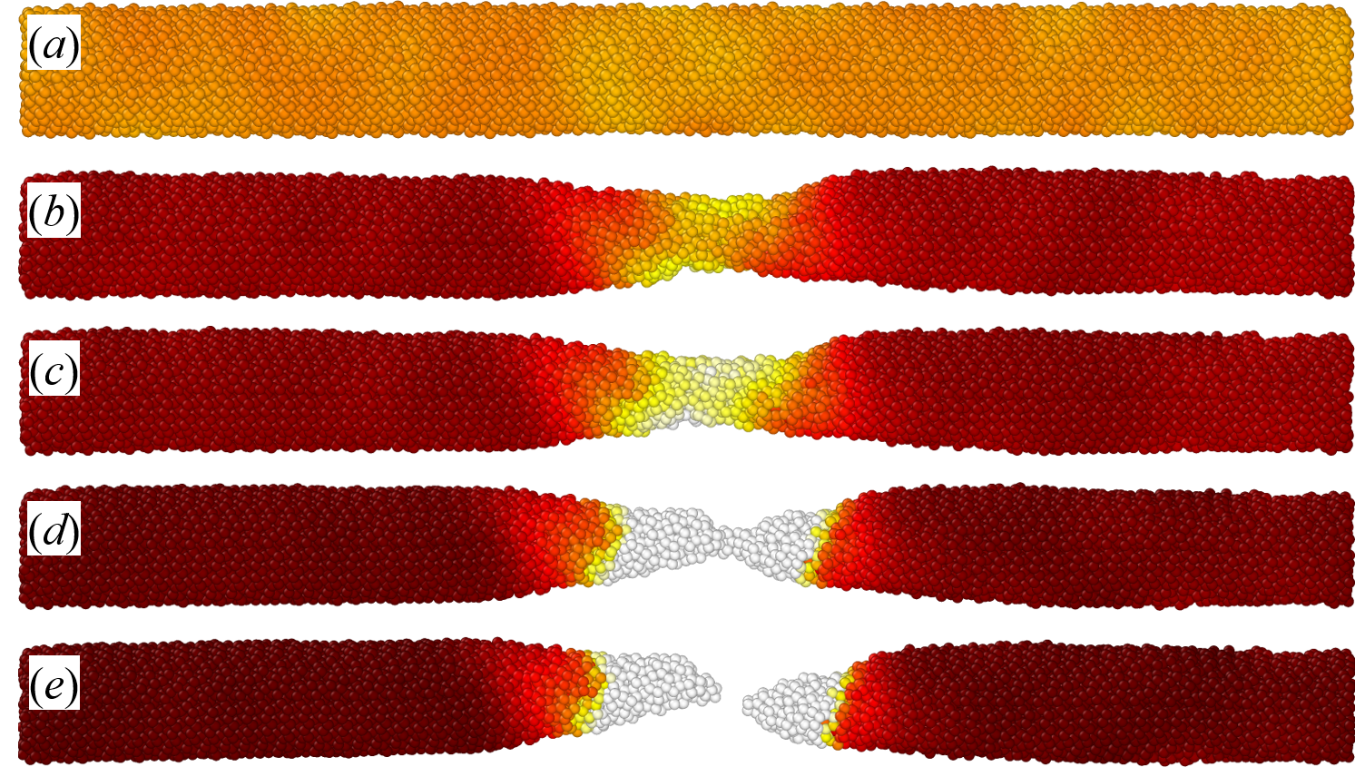
Mechanical Behavior Modeling: Motivation and Objectives
Simulation results of the mechanical response of SiGe nanowires.

Slide 21
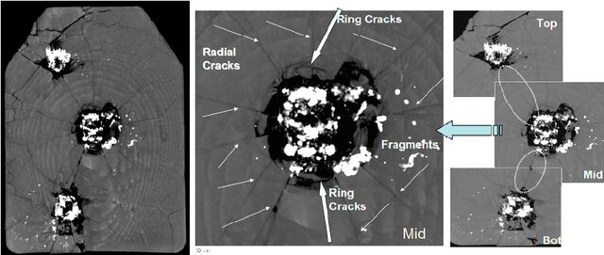
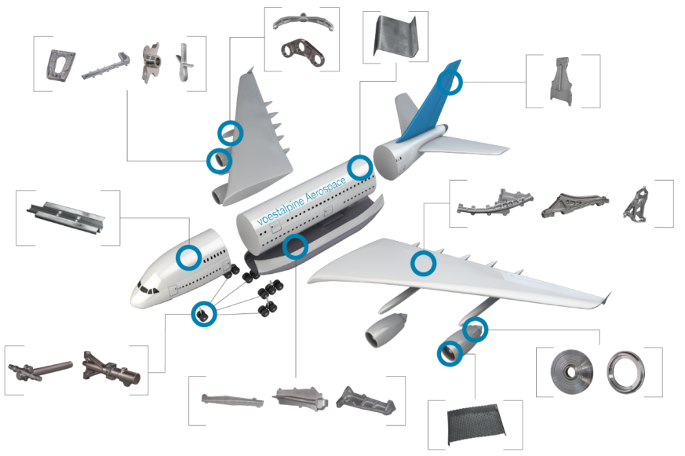
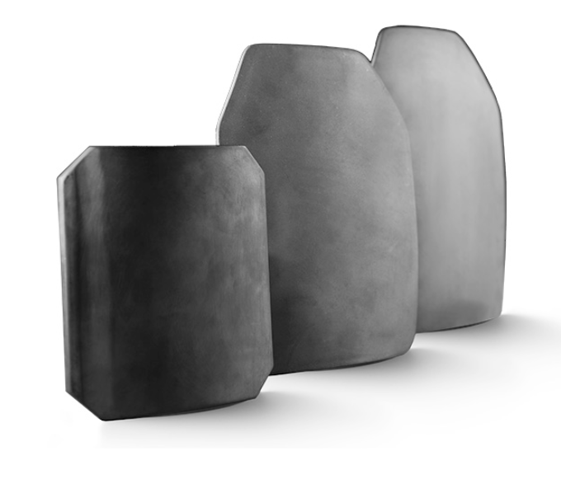
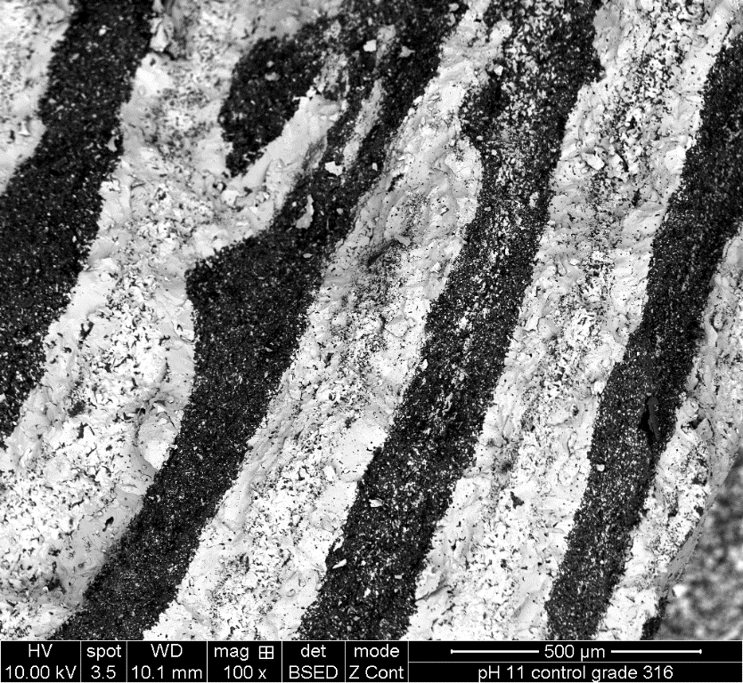
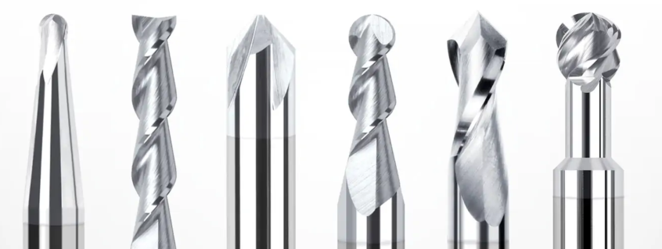
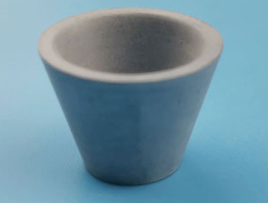
Mechanical Behavior Modeling: Motivation and Objectives

Slide 22
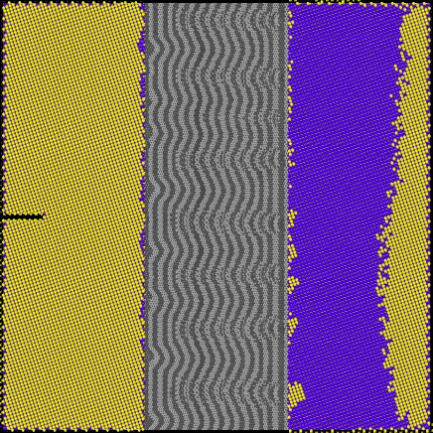
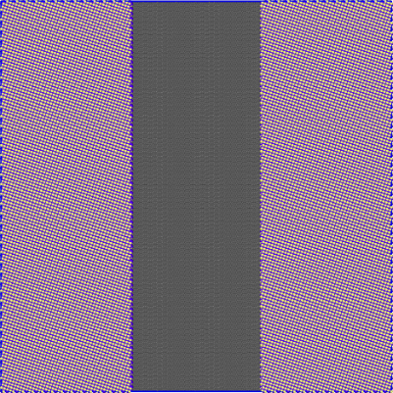
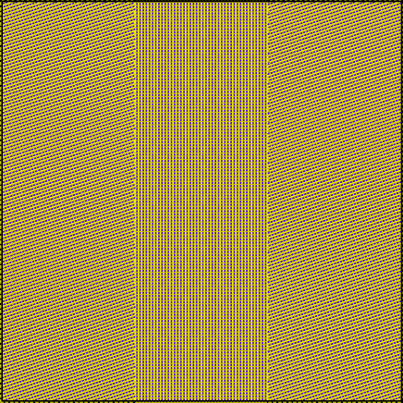

Mechanical Response and Crack Propagation
SiC
Gr
SiC
SiC
SiC
SiC
SiC
X -120
Y 210
X 110
Y -110
X -120
Y 210
Illustration of the modeled structure of impact-resistant SiC/graphite ceramic composites.

Slide 23
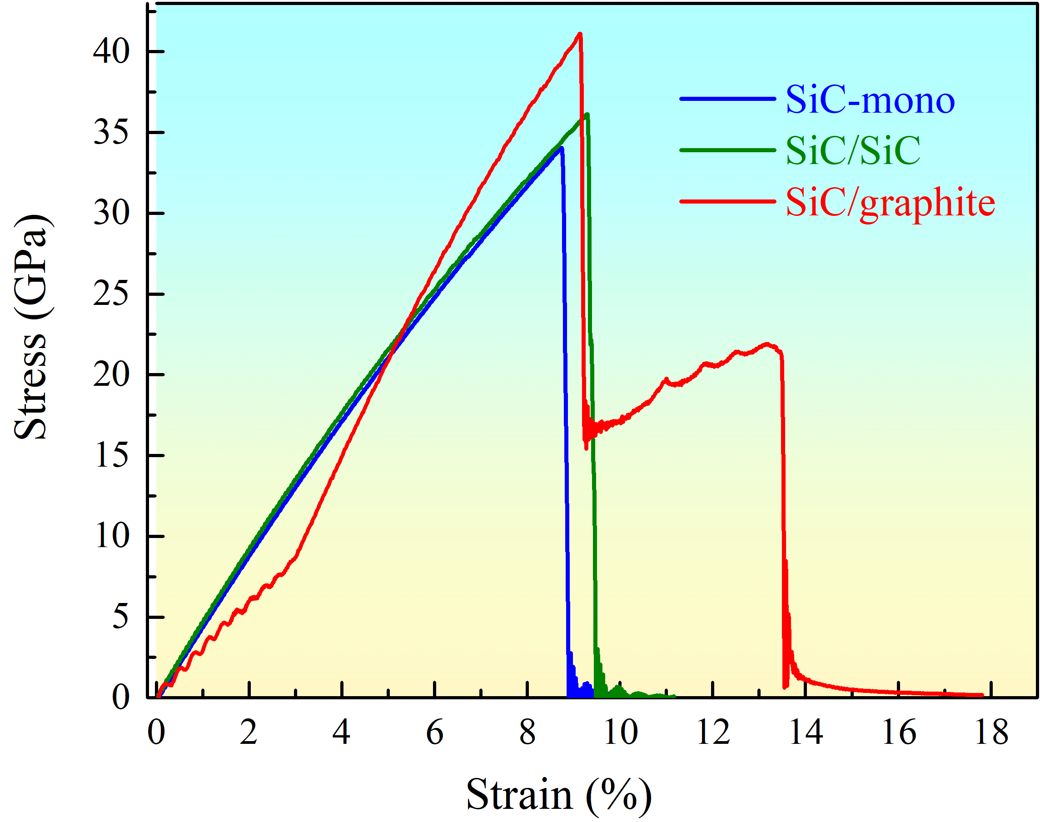
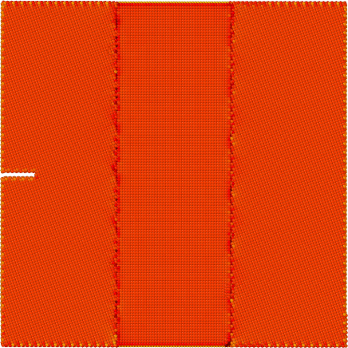
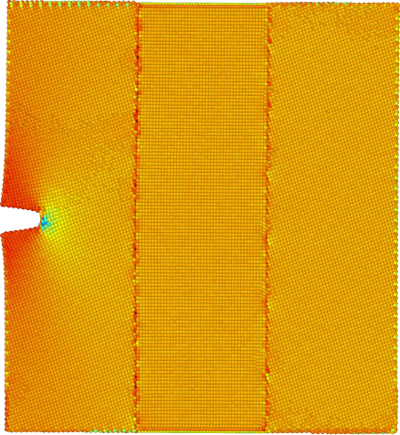
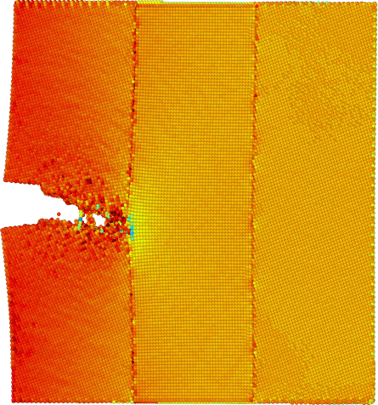




Mechanical Response and Crack Propagation
ε=0%
ε=9.2%
ε=9.4%
ε=9.7%
ε=9.9%
ε=10.1%
Simulation of crack propagation in SiC-based composites.

Slide 24






Mechanical Response and Crack Propagation
ε=0%
ε=9.5%
ε=9.6%
ε=9.7%
ε=13.8%
ε=14.0%
Simulation of crack propagation in SiC-based composites.

Slide 25

Machine Learning for Thermal Conductivity
Symbolic Regression
approximates the relation between an input and an output through analytic mathematical formula
Interpretability
Physical content
Suitable for small data sets

Slide 26



Machine Learning for Thermal Conductivity
Symbolic Regression
MD result:
SR result:

Slide 27


Machine Learning for Thermal Conductivity
Symbolic Regression

Slide 28


Machine Learning for Thermal Conductivity
Symbolic Regression

Slide 29




Machine Learning for Carrier Mobility in Si
Symbolic Regression
models for mobility in silicon
Brooks & Herring
Conwell & Weisskopf
Fletcher
Caughey & Thomas
Dorkel
Masetti
Arora
Klaassen (Philips)
Noor Mohammad
…

Slide 30












Machine Learning for Carrier Mobility in Si
Symbolic Regression
electron:
electron:
hole:
hole:

Slide 31




Machine Learning for Carrier Mobility in Si
Symbolic Regression
electrons, majority carriers
holes, minority carriers
APE to Klaassen's theory

Slide 32

Machine Learning for Carrier Mobility in Si
Symbolic Regression

Slide 33


Machine Learning for Thermal Conductivity
GB, RF, SVR

Slide 34



Machine Learning for Thermal Conductivity
GB, RF, SVR

Slide 35

Machine Learning for Thermal Conductivity
Physics-Informed Neural Networks

Slide 36

Machine Learning for Thermal Conductivity
PINN
Physics-informed convolutional encoder-decoder neural network maps

Slide 37









Machine Learning for Thermal Conductivity
PINN
TC = 130.3 W m⁻¹K⁻¹
TC = 83.02 W m⁻¹K⁻¹
TC = 15.73 W m⁻¹K⁻¹

Slide 38



Machine Learning for Energy-Conversion Structures
The primary task:
to quantify iron impurities in silicon solar cells using data derived from current–voltage characteristics
thermodynamic equilibrium
carrier injection

Slide 39

Machine Learning for Energy-Conversion Structures
Classic Regression
The workflow of the ML pipeline

Slide 40





Machine Learning for Energy-Conversion Structures
Classic Regression
SCAPS 3.3.11

Slide 41


Machine Learning for Energy-Conversion Structures
Classic Regression
Simulated data

Slide 42


Machine Learning for Energy-Conversion Structures
Classic Regression
Experimental data

Slide 43


Machine Learning for Energy-Conversion Structures
Computer vision
Simulation
Experiment

Slide 44

Machine Learning for Energy-Conversion Structures
Computer vision

Slide 45

Machine Learning for Energy-Conversion Structures
Computer vision

Slide 46





Machine Learning for Energy-Conversion Structures
Computer vision
Simulated data

Slide 47





Machine Learning for Energy-Conversion Structures
Computer vision
Experimental data

Slide 48
Future Work
Extension of Atomistic Simulations:
Atomistic simulations of thermal transport in phase-change composites with different types of fillers
Investigation of mechanical and thermal properties of nanomaterials under varying conditions
Machine Learning Enhancement:
Expand training datasets with simulated and experimental data for improved generalization.
Explore graph neural networks and physics-informed ML for predicting defect-driven phenomena.
Thermoelectric and Energy-Conversion Optimization:
Apply ML-guided materials screening to identify structures with enhanced thermoelectric figure merit.
Validation and Experimental Collaboration:
Compare simulation and ML predictions with experimental measurements of nanostructured ceramics and SiGe-based devices.
Collaborate with experimental groups to validate models and refine parameters.

Slide 49
Acknowledgements
We sincerely thank the National Research Foundation of Ukraine for financial support of this project.
We are grateful to Taras Shevchenko National University of Kyiv for providing excellent research facilities and support.
Special thanks to the Project Supervisor and the project team for their coordinated and dedicated work.

Slide 50
Thank you
for your attention!

